Slide 1


Methodology
1
Notes:
Aluminium alloys are among the most worldwide demanded alloys and their demand grows every year because they count on many advantageous characteristics, being the principal their low density and low price, especially of interest in the vehicle sector. The European Aluminium association estimated a 40% growth in demand for aluminium between 2019 and 2050. Aluminium sheets are the most popular way of use of this material and they are widely employed in many relevant sectors because they can be cut and formed into different desired shapes. Therefore, there is a strong incentive to optimise the performance of this product and competition in the market is very strong.

Slide 2
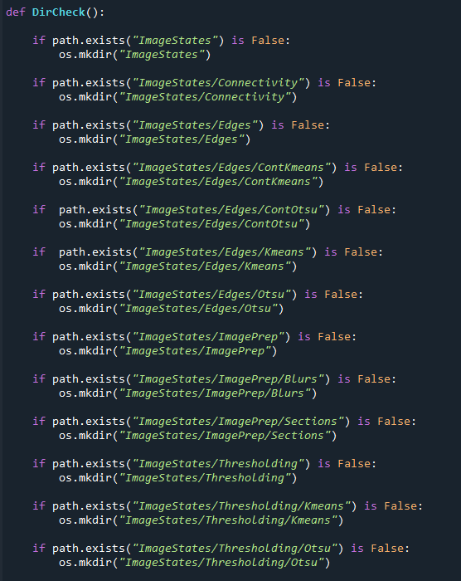

Slide 3
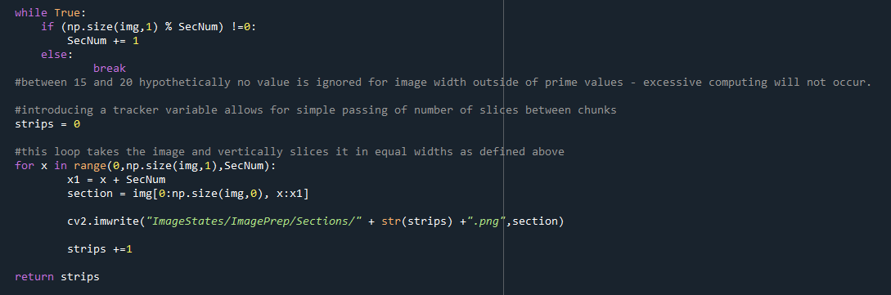

Slide 4
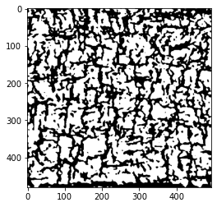
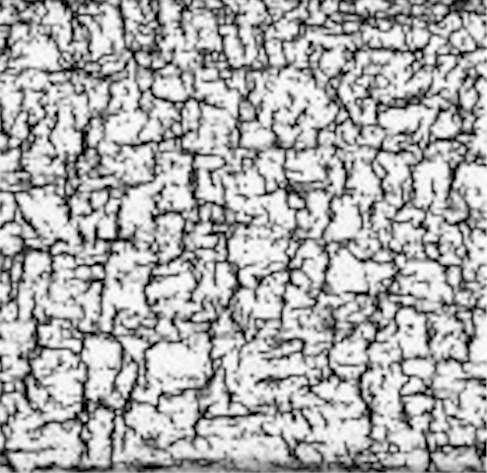

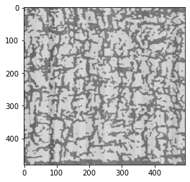
1
Notes:
Aluminium alloys are among the most worldwide demanded alloys and their demand grows every year because they count on many advantageous characteristics, being the principal their low density and low price, especially of interest in the vehicle sector. The European Aluminium association estimated a 40% growth in demand for aluminium between 2019 and 2050. Aluminium sheets are the most popular way of use of this material and they are widely employed in many relevant sectors because they can be cut and formed into different desired shapes. Therefore, there is a strong incentive to optimise the performance of this product and competition in the market is very strong.

Slide 5
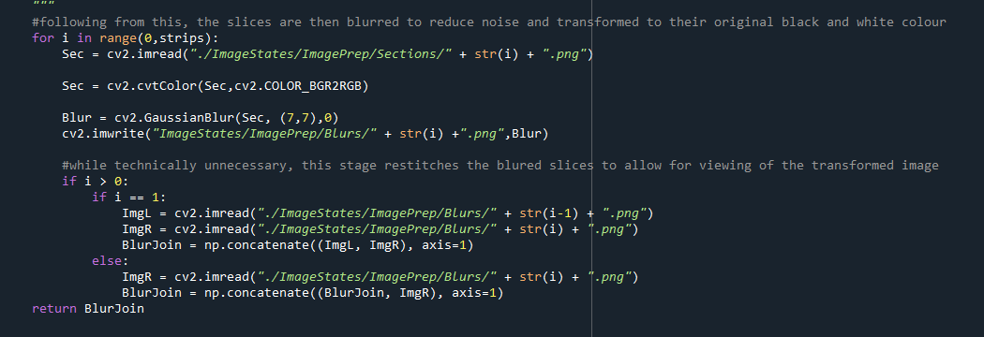

Slide 6
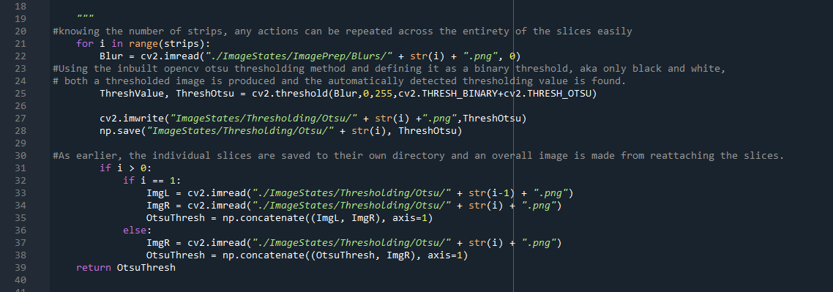

Slide 7
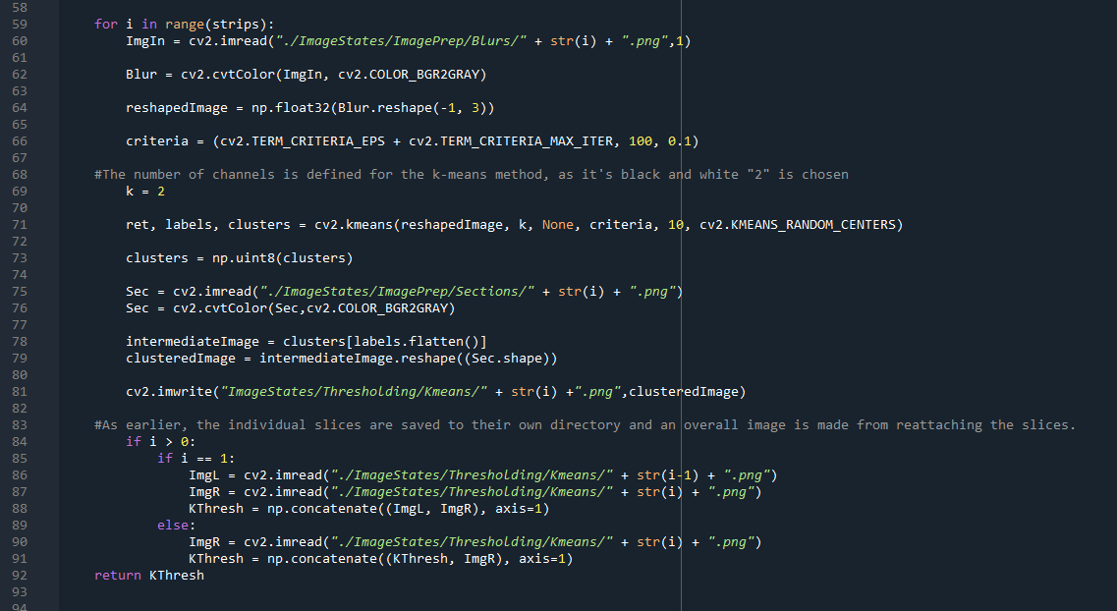

Slide 8
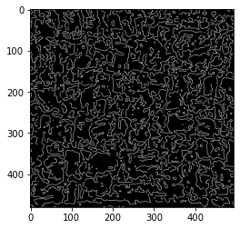

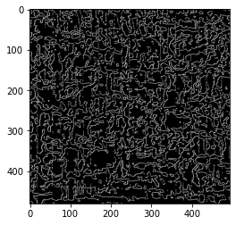
1
Notes:
Aluminium alloys are among the most worldwide demanded alloys and their demand grows every year because they count on many advantageous characteristics, being the principal their low density and low price, especially of interest in the vehicle sector. The European Aluminium association estimated a 40% growth in demand for aluminium between 2019 and 2050. Aluminium sheets are the most popular way of use of this material and they are widely employed in many relevant sectors because they can be cut and formed into different desired shapes. Therefore, there is a strong incentive to optimise the performance of this product and competition in the market is very strong.

Slide 9
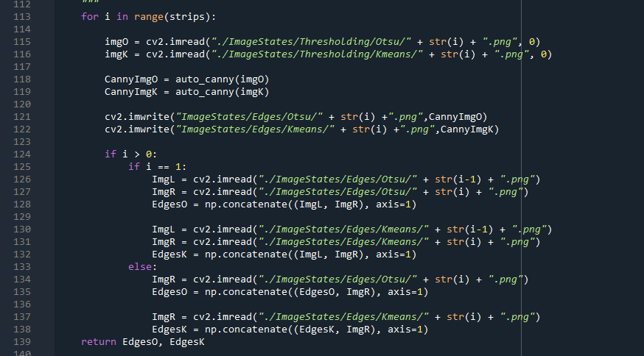

Slide 10
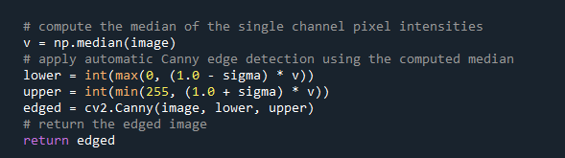

Slide 11
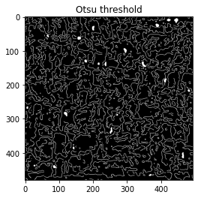
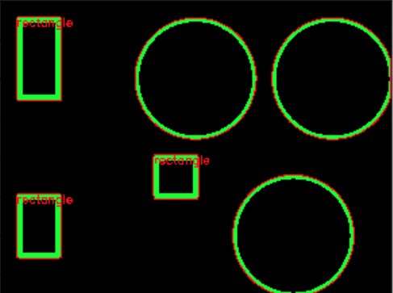
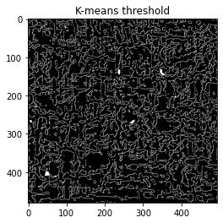
1
Notes:
Aluminium alloys are among the most worldwide demanded alloys and their demand grows every year because they count on many advantageous characteristics, being the principal their low density and low price, especially of interest in the vehicle sector. The European Aluminium association estimated a 40% growth in demand for aluminium between 2019 and 2050. Aluminium sheets are the most popular way of use of this material and they are widely employed in many relevant sectors because they can be cut and formed into different desired shapes. Therefore, there is a strong incentive to optimise the performance of this product and competition in the market is very strong.

Slide 12


Slide 13
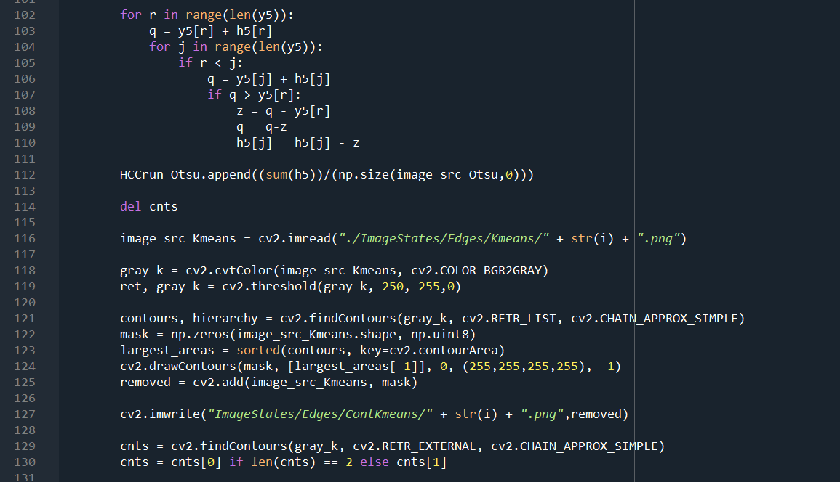

Slide 14
